Slide 1

Wireless Penetration Testing

Slide 2

Characteristics
Uses radio frequencies
Connecting to the network via an Access Point(AP)
Uses the 802.11 framework

Slide 3
Terms
BSSID
SSID
Channel
Security mode

Slide 4
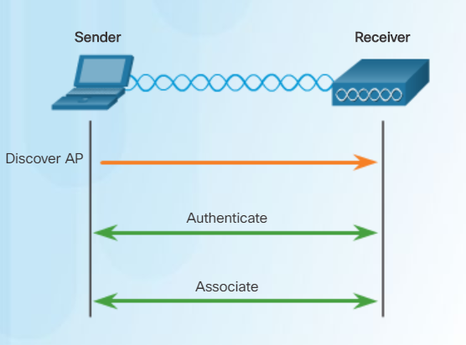
Wireless connection

Slide 5
Wireless security – WPA2
Uses Advanced Encryption Standard (AES)
Longer password required

Slide 6
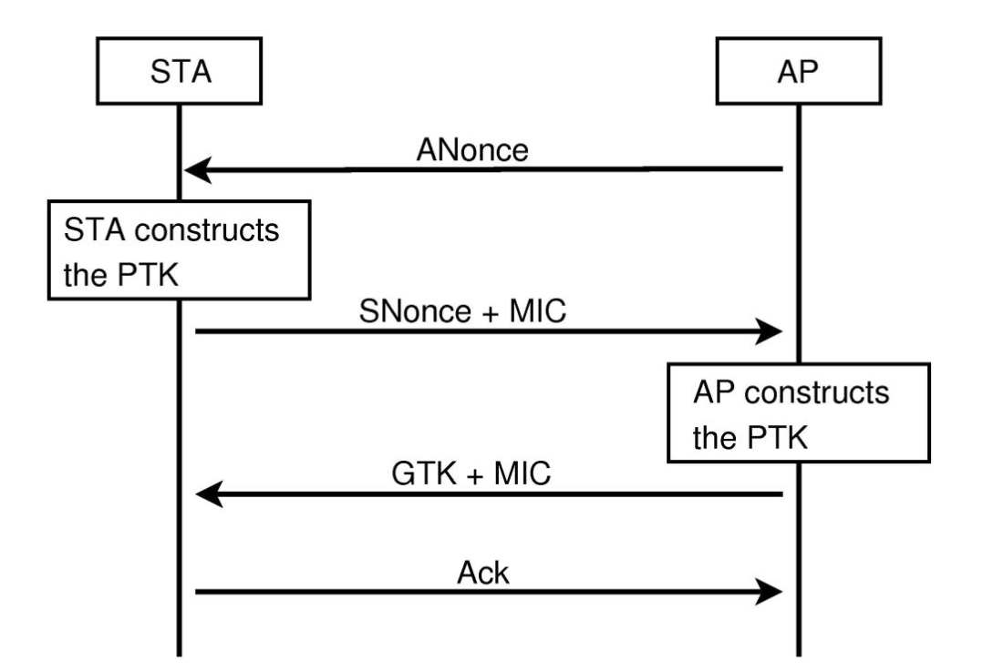
WPA2 4-way handshake

Slide 7
Tools required for a PenTest (hardware)
Wireless Card

Slide 8
Terms
Wireless Card
Kali Linux / AttifyOS

Slide 9
Terms
Aircrack/ lscript
John the ripper / hashcat

Slide 10
Demonstration

Slide 11
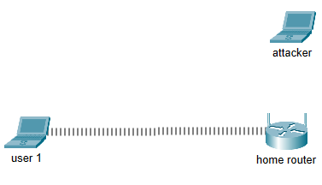
Environment

Slide 12
